Slide 1
Ai Hand Detection
CAPSTONE PROJECT
Presented By:
1. Sanjana Pandya-[Shri Labhubhai Trivedi Institute of Engineering & Technology, Rajkot]-Computer

Slide 2
OUTLINE
Problem Statement (Should not include solution)
Proposed System/Solution
System Development Approach (Technology Used)
Algorithm & Deployment
Result
Conclusion
Future Scope
References

Slide 3
Problem Statement
"To develop an AI system capable of accurately detecting and localizing human hands in images or video frames, enabling applications in gesture recognition, human-computer interaction, and augmented reality."

Slide 4
Proposed Solution
The proposed system aims to address the challenge of predicting the required at to ensure a stable AI Hand Detection. This involves leveraging data analytics and machine learning techniques to forecast demand patterns accurately. The solution will consist of the following components:
Deep Learning Approach: Utilize convolutional neural networks (CNNs) for learning hierarchical features from hand images.
Training Data: Annotate and use large datasets of hand images to train the CNN models.
Architecture Selection: Explore architectures like Faster R-CNN, YOLO (You Only Look Once), or SSD (Single Shot MultiBox Detector) for efficient real-time detection.
Real-time Performance: Optimize for real-time processing to ensure quick detection in video streams or live camera feeds.
Post-processing Techniques: Apply methods to refine detection boundaries and reduce false positives.
Deployment on Edge Devices: Implement the solution to run efficiently on edge devices, enabling applications in gesture recognition, robotics, and augmented reality.
Integration: Ensure seamless integration into various applications requiring hand detection for human-computer interaction and interactive systems.

Slide 5
System Approach
The "System Approach" section outlines the overall strategy and methodology for developing and implementing the Ai hand detection system. Here's a suggested structure for this section:
Data Collection and Annotation:Gather a diverse dataset of hand images across different backgrounds, lighting conditions, and orientations.
Preprocessing :Normalize and preprocess images to enhance feature extraction during training.
Model Selection: Choose a suitable deep learning architecture for object detection, such as Faster R-CNN, YOLO (You Only Look Once), or SSD (Single Shot MultiBox Detector).
Training and Validation: Train the selected model on the annotated dataset using GPUs for faster processing.
Deployment: Deploy the trained model on edge devices or cloud platforms for real-time hand detection.
User Interface and Interaction: Develop a user-friendly interface for interacting with the hand detection system.

Slide 6
Algorithm & Deployment
In the Algorithm section, describe the machine learning algorithm chosen for Ai Hand Detection. Here's an example structure for this section:
Environment Setup: Choose deployment environment based on performance requirements (edge devices vs. cloud).Set up necessary software frameworks and dependencies for deployment.
Integration with Cameras or Video Feeds: Develop interfaces to capture video streams from cameras or input video files.Implement preprocessing steps (e.g., resizing, normalization) to prepare frames for inference.
Inference and Real-time Detection: Deploy the trained model on the selected deployment environment (e.g., edge devices, cloud servers).Implement optimized inference pipelines to ensure real-time processing of video frames.
Scalability and Performance Monitoring: Monitor system performance metrics such as inference speed, throughput, and resource utilization.Scale the deployment infrastructure to handle varying workloads and ensure robust performance under different conditions.
User Interface and Interaction: Develop a user-friendly interface to visualize real-time hand detection results.Incorporate feedback mechanisms to improve model performance and user experience based on user interactions.
Security and Compliance :Implement security measures (e.g., encryption, access controls) to protect data and ensure compliance with privacy regulations.Regularly update the deployed model with new data and improvements to maintain accuracy and reliability.

Slide 7
Result
The AI hand detection project aims to achieve high accuracy and real-time performance in identifying and localizing human hands within images or video streams. Successful outcomes include robust detection capabilities across diverse environments and lighting conditions, minimizing false positives and negatives. User feedback on usability and interface effectiveness is crucial for optimizing the system's design. Furthermore, the project aims to ensure scalability, security, and compliance with data privacy regulations, facilitating its integration into various applications such as gesture recognition, robotics, and augmented reality. Overall, the project's success is measured by its ability to enhance operational efficiency, innovation, and user experience in interactive and automated systems.

Slide 8
Conclusion
In conclusion, the AI hand detection project represents a significant advancement in computer vision technology, aiming to accurately and swiftly identify human hands in various contexts. By leveraging deep learning models and real-time processing techniques, the project enhances applications in gesture recognition, human-computer interaction, and robotics. The system's ability to operate effectively across different environments, coupled with user-friendly interfaces and adherence to security standards, underscores its potential impact in improving efficiency and innovation in interactive technologies.

Slide 9
Future scope
Multimodal Integration: Incorporating gestures with voice and facial recognition for seamless human-computer interaction.
Edge Computing: Enhancing real-time processing capabilities on edge devices for faster response times.
Fine-grained Analysis: Improving accuracy in hand pose estimation and gesture classification for precise interaction
AIoT Integration: Integrating with Internet of Things (IoT) devices to enable gesture-based control in smart environments.
Privacy and Security: Developing robust solutions to protect user data and ensure secure interaction methods.

Slide 10
References
(PDF) Hand Gesture Recognition and Control for Human-Robot Interaction Using Deep Learning (researchgate.net)
Handtrack.js: tracking hand interactions in the browser using Tensorflow.js and 3 lines of code — The TensorFlow Blog
Real-time Hand Gesture Recognition using TensorFlow & OpenCV - TechVidvan

Slide 11

course certificate 1

Slide 12
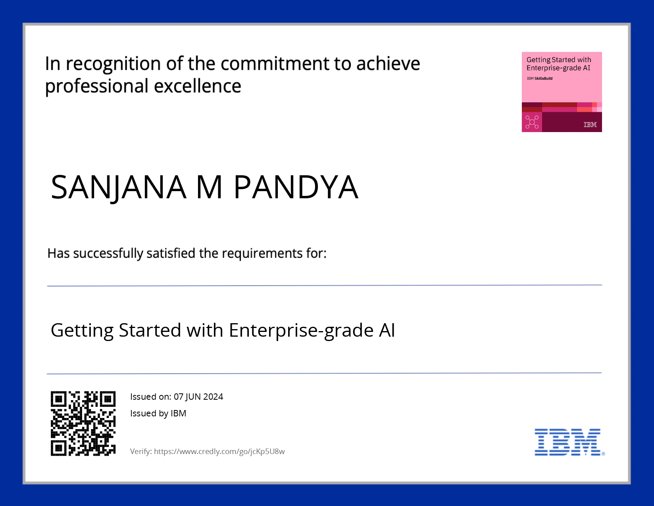
course certificate 2

Slide 13
THANK YOU

